Slide 2
Learn With Us: Data Science and AI
Gouri Rajesh [MLSA Alpha]
Goutam Shanbhag [MLSA Alpha]
Arohi Jain [MLSA Alpha]

Slide 3



Today’s Speakers
Gouri Rajesh
[MLSA Alpha]
Goutam Shanbhag [MLSA Alpha]
Arohi Jain
[MLSA Alpha]

Slide 4
Let’s get started!
What path should I follow?
Artificial Intelligence
Data Science
Data Analysis
Machine Learning
Deep Learning

Slide 5
Why Data Science?
In earlier times, the data we talk about today was entirely restricted to the human brain (such as remembering phone numbers or birthdays) but now its scope has been extended to storage devices so that we humans can remember and use our intelligence for more complex and meaningful tasks.
In today’s world we have data all around us. There is absolutely nothing that works without data.
Machines have made our lives easier and the way they do this is by collecting vast amount of data. Now you may ask why data? Machines are dumb and need to be trained to think like us humans and they only way to do that is feed it data which is equivalent to years of knowledge and experience in human terms.
Machines have become a staple in our lives and constantly helping them improve and in turn improve the human way of living has been the aim of many organizations. Data Science plays a major role in the same and hence its demand has grown exponentially over the years and will continue to be among the top skills in demand even in future.
Notes:
// Can be removed….(?)

Slide 6
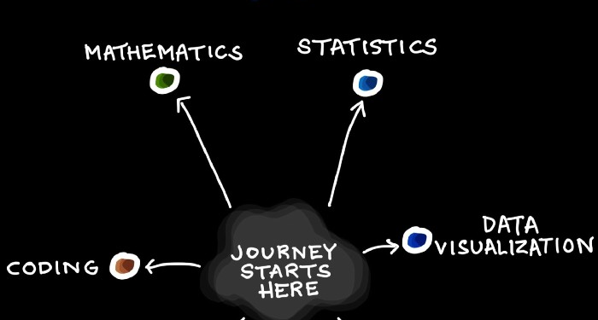
Data Science
Data Science can simply be defined as the art of collecting data, analyzing the data, visualizing the data, try to make sense of it and applying algorithms to this data to solve some real life problems or just understand data from a machine’s perspective.

Slide 7
Reasons for the Rise of Data Science -
Vast amounts of data currently available and being generated.
Rise of inexpensive computing.
Data Science is the intersection of three sectors -
Hacking skills / Programming
Math and statistics knowledge
Substantive research

Slide 8
Steps to a Data Science Project -
Formulate a question you want to answer.
Get the data.
Apply statistical and mathematical knowledge to the data.
Get the data organised using data.
Analyze and communicate your results.

Slide 9
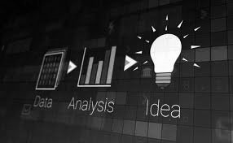
What is Data Analysis?
Data analysis is a process of inspecting, cleansing, transforming and modeling data with the goal of discovering useful information, informing conclusions and supporting decision-making.

Slide 10
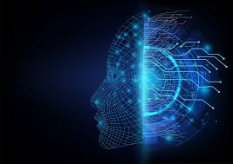
What is Artificial Intelligence?
Artificial intelligence (AI) refers to the simulation of human intelligence in machines that are programmed to think like humans and mimic their actions. The term may also be applied to any machine that exhibits traits associated with a human mind such as learning and problem-solving.

Slide 11
What is Machine Learning?
Machine Learning is an application of Artificial Intelligence (AI) that provides systems the ability to automatically learn and improve from experience without being explicitly programmed. ML focuses on the development of computer programs that can access data and use it to learn for themselves.
Notes:
// Insert a picture….Maybe(?)

Slide 12
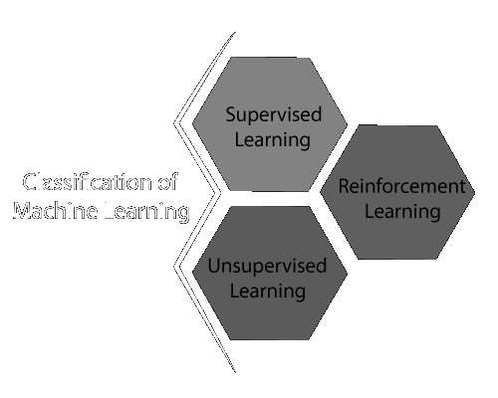
Types of Machine Learning -
Supervised Learning
Unsupervised Learning
Reinforcement Learning

Slide 13
Supervised Learning
Supervised learning is where you have input variables (x) and an output variable (Y) and you use an algorithm to learn the mapping function from the input to the output.
Y = f(X)
Can be grouped into two categories -
Regression
Classification
Notes:
// Explain examples and mention algorithms that fall into each category.

Slide 14
Unsupervised Learning
Unsupervised learning is where you only have input data (X) and no corresponding output variables. The goal for unsupervised learning is to model the underlying structure or distribution in the data in order to learn more about the data.
Can be grouped into two categories -
Clustering
Outlier Detection/ Association
Notes:
// Explain examples and mention algorithms that fall into each category.

Slide 15
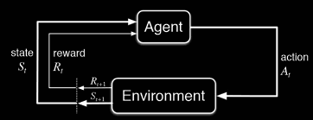
Reinforcement learning
Reinforcement Learning is when the algorithm has a feedback system involved. It accepts positive or negative feedback from the user and sends it back to the algorithm to improve its accuracy.

Slide 16
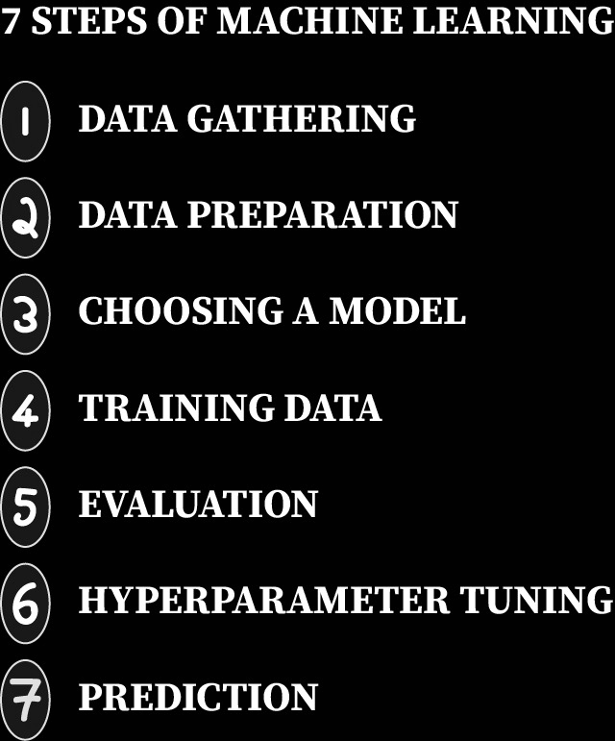
Project on Machine Learning -
Linear classification

Slide 17
What is Deep Learning?
Deep learning is a subset of machine learning where artificial neural networks, algorithms inspired by the human brain, learn from large amounts of data.
A deep learning algorithm would perform a task repeatedly, each time tweaking it a little to improve the outcome.
We refer to ‘deep learning’ because the neural networks have multiple (deep) hidden layers that enable learning.

Slide 18
What is deep learning used for?
Automated Driving: Automotive researchers are using deep learning to automatically detect objects such as stop signs and traffic lights.
Aerospace and Defense: Deep learning is used to identify objects from satellites that locate areas of interest, and identify safe or unsafe zones for troops.
Medical Research: Cancer researchers are using deep learning to automatically detect cancer cells.
Electronics: Deep learning is being used in automated hearing and speech translation.
Chatbots and service bots, Facial Recognition and much more.

Slide 19
Let’s look at a few sub-topics under deep learning:
Feed Forward Network
The feed-forward network is an artificial neural network composed of many input, hidden and output layers.
The inputs and corresponding weights and bias are fed into the network which is used to calculate the weighted sum and then activated by an activation function.
The output from the activated artificial neuron then passed to other hidden layers which receive this as their input.
The process continues throughout the entire network and we finally receive the output from the network.

Slide 20
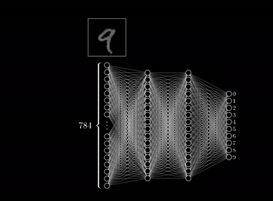
Feed-forward network for number recognition

Slide 21
Back-Propagation
When we design a feed forward network, it is almost highly impossible that at the first go we can set the weights such that we retrieve an accurate output. This is where backpropagation comes in.
Backpropagation is the method of traversing back from the output layer to the hidden layers of the network and tweaking the weights little by little at each iteration in order to reduce the error of the network, which is also known as the cost.
This means that we need to perform thousands of iterations or “epochs”, changing the weights little by little and to finally observe the accurate input.

Slide 22
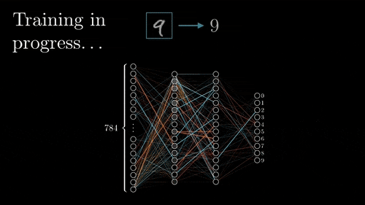
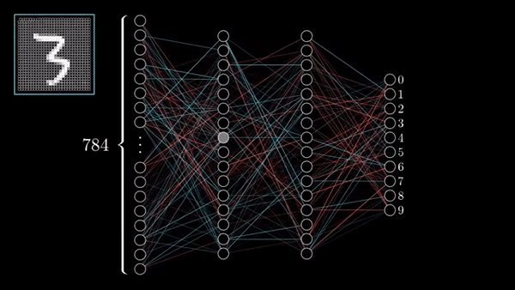
Large Error in the output
Weight adjustment through backpropagation

Slide 23
Gradient Descent
Gradient descent is a minimization technique to reduce the error/cost of the neural network.
It is a method of backpropagation which updates the weights associated with the inputs exponentially.
Gradient descent is an optimization algorithm used to minimize some function by iteratively moving in the direction of steepest descent as defined by the negative of the gradient.

Slide 24
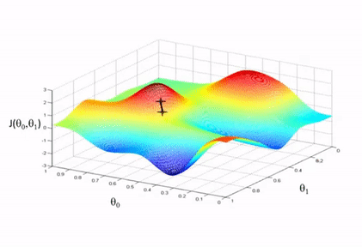
Gradient Descent Visualization
RED-Highest
BLUE-Lowest

Slide 25
Recurrent Neural Network
Recurrent neural networks are a special type of ANN which follows a feedback system. The output sent out by one neuron is again fed back to the same neuron along with incoming input. This forms a loop around the neuron which allows us to process sequential data.
More advanced version of RNNs are LSTM (Long Short Term Memory) and GRU (Gated Recurrent Units). They have large memory capabilities compared to RNN and hence can process large amounts of sequential data at a time and no input is lost during back propagation.

Slide 26

Structure of Recurrent Neural Networks

Slide 27

It is used in systems such as text prediction, speech recognition, video tagging and much more.

Slide 28
Microsoft Azure for Machine Learning
Advantages -
Higher computing power
Unlimited Storage Capacities
Access from remote locations
Hardware freedom and reliability
Backup and Recovery
Cost efficient (Pay only for the resources you use)

Slide 29
Thank You!
Contact us:
Gouri.Rajesh@studentambassadors.com [Gouri Rajesh]
Goutam.Shanbhag@studentambassadors.com [Goutam Shanbhag]
Arohi.Jain@studentambassadors.com [Arohi Jain]

